Slide 1


Data Science Final Project
Eric Adjei
Demetrius Fields

Slide 2

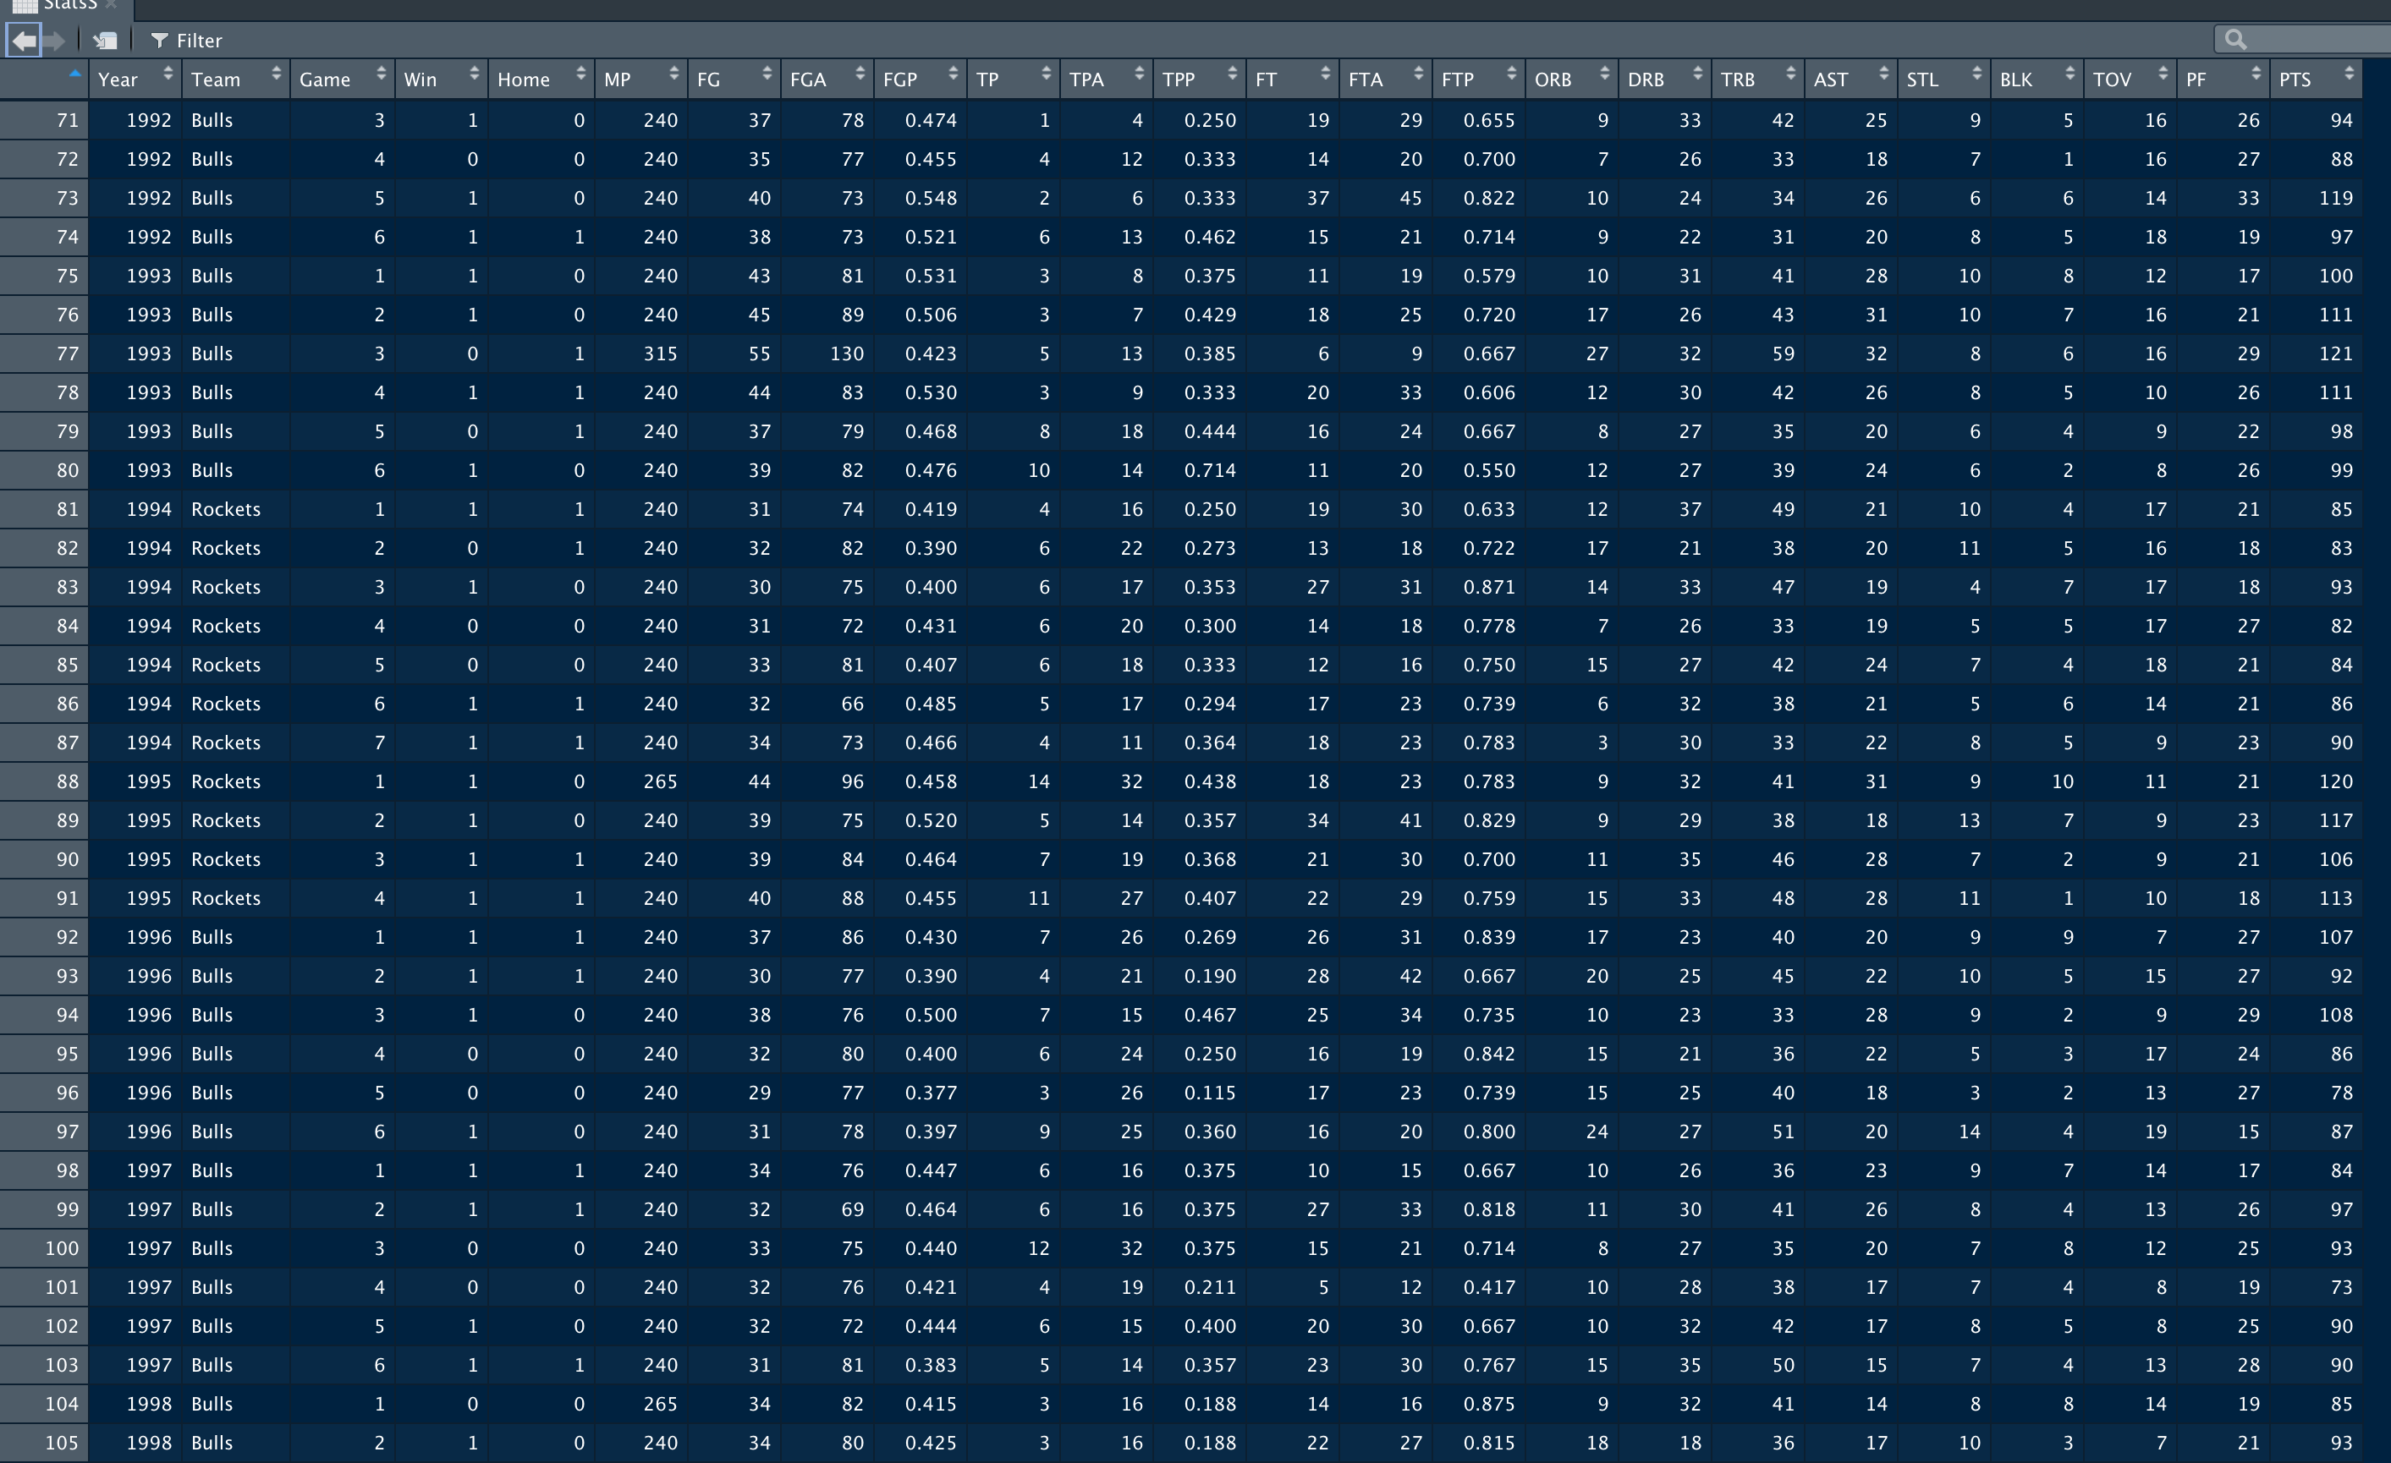
1980 - 2018 NBA Championship Stats
This Photo by Unknown Author is licensed under CC BY-SA

Slide 3
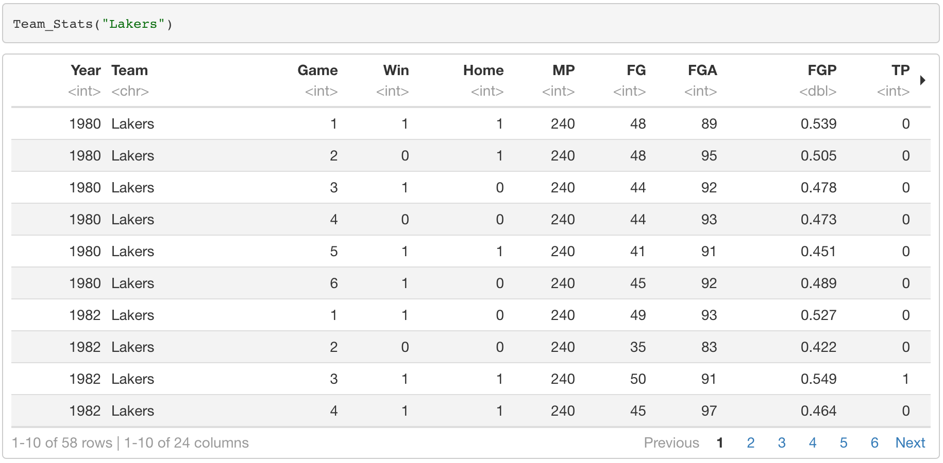
Stats of Team

Slide 4
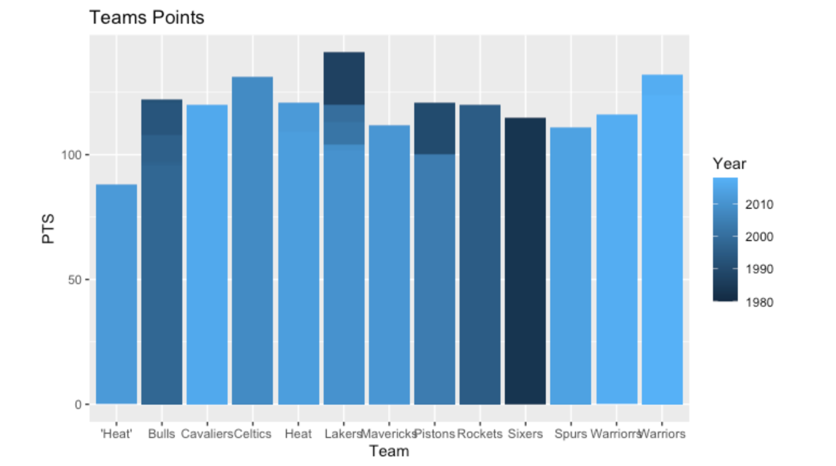
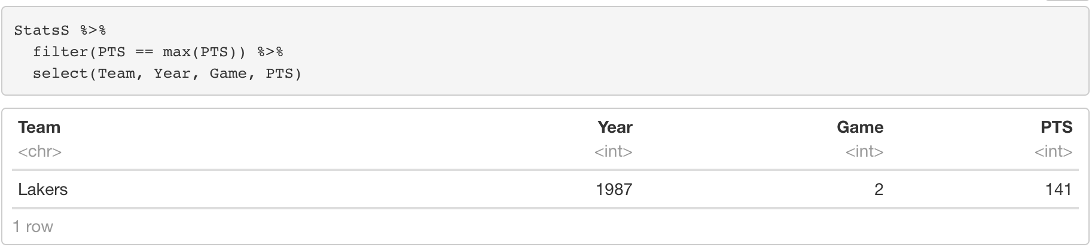
Team with Most Points

Slide 5
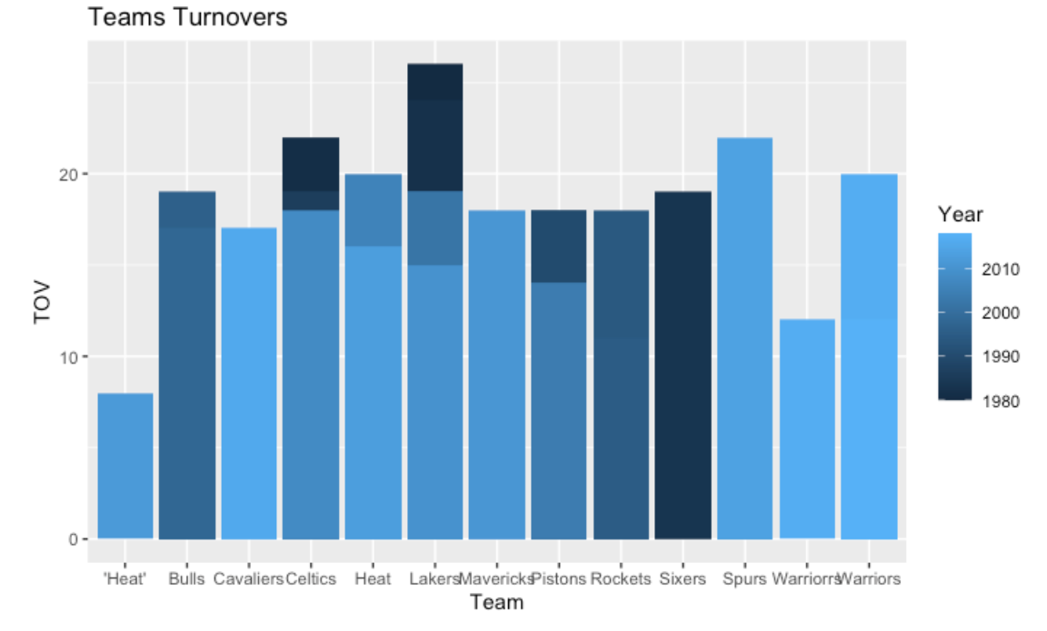
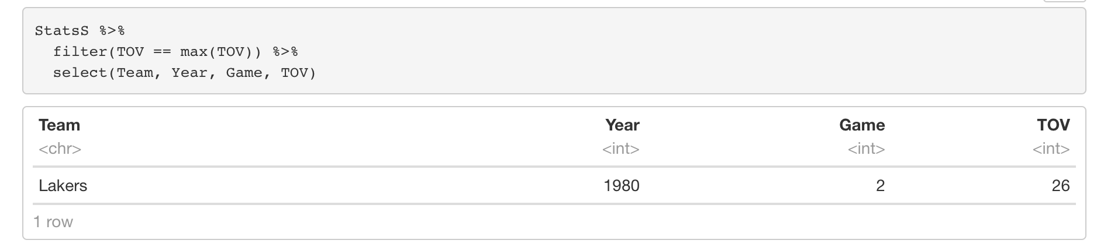
Team with Most Turnovers

Slide 6
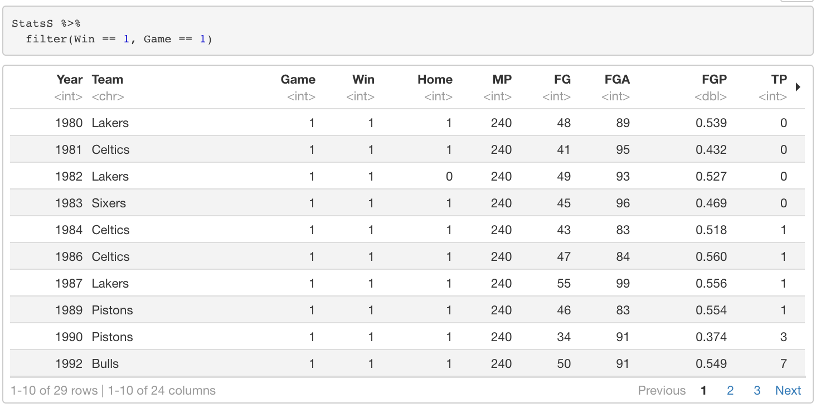
Won the First Game

